Slide 1
Study of trends and issues related to Kisan Credit Card (KCC) and its impact on Rural Economy
By
Avanish Mishra
Indira Gandhi Institute of Development Research
Under the guidance of
Rajiv Nandan
AGM, NABARD

Slide 2
Introduction: About the Scheme
Introduction of the scheme - August 1998
Extension to the investment credit requirement of farmers viz. allied and non-farm activities - 2004
Extension to fisheries and allied activities - 2019
Aim: Providing adequate and timely credit support from the banking system under a single window with flexible and simplified procedure to the farmers for their cultivation and other needs
Implementing Agencies: SCBs, RRBs, Cooperative Banks
‘Ghar Ghar KCC Abhiyaan’: coverage of PM Kisan beneficiary under KCC

Slide 3
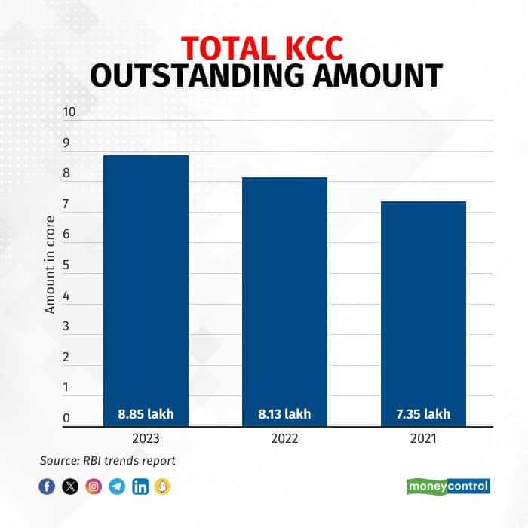
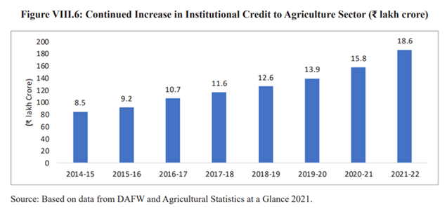
Introduction: Current Statistics
Total KCCs by the end of 2023 = 7.35 crore
Total sanctioned limit = Rs. 8.85 lakh crores
Total KCC issued to allied sectors = 2.37 crore

Slide 4
Literature Review
Vinod Kumar, 2021: Reviewed trends and pattern in agriculture credit in UP using secondary data from various sources such as Handbook of Statistics on Indian States, NABARD Annual Reports, State Focus Papers and Potential linked Credit Plan, etc.
Gyanendra Mani, 2016: Conducted a comprehensive study on implementation of revised KCC scheme using primary data of 71 branches of 32 banks and a total of 969 farmers covering 714 KCC holders and 255 other non-KCC farmers.
Areendam Chanda, 2012: Using data from 2004-05 to 2009-10, the paper critically examines the determinants of KCC lending across states in India and districts in Bihar.
Sheela B. and H. Rajashekar, 2023: Analyzed the period-wise and agency-wise growth of the Kisan Credit Card scheme in Karnataka.

Slide 5
Objective
To analyze the progress of the KCC Scheme since its inception with focus on bottlenecks/constraints in its implementation.
To assess how KCC scheme has helped in accelerating the institutional credit flow and brought out change in productivity and efficiency at the field level.
To assess the coverage of KCC scheme for small/marginal farmers, tenant farmers etc. and assess the utilization of scheme.
To suggest measures towards modification of the scheme to ensure inclusion of excluded farmers and improve overall efficacy of the scheme.

Slide 6
Methodology
Headings | Description
Type of Research | Descriptive and Inferential
Sampling Technique | Convenience sampling
Sample State | Bihar
Sample Districts | 02 (West Champaran & East Champaran)
Sample Size | No. of Banks – 2 each from each of 3 agencies No. of KCC Farmers – 10 Farmers from each of the Bank No. of Non-KCC Farmers – 5 each of similar background as of KCC Farmers
Data Sources | Primary: Interviews, Field Visits, Focus Group Discussions Secondary: Reports of RBI, NABARD, Govt. of India
Research Instruments | Questionnaire
Analytical Tool | Measures of central tendency, Techniques of Statistical Inference

Slide 7
Sample Description
District: West Champaran
Highlights:
Biggest district in terms of area in Bihar
Largest producer of sugarcane in Bihar
3rd in wheat production in Bihar
Well-defined irrigation system
Headings | Values (in FY23)
Banking Network | 20 Banks, 204 Branches
Credit flow to agriculture and allied sector | Rs. Crore
Outstanding Loans | Rs. 29.02 Crore
Source: Potential Linked Credit Plan 2024-25

Slide 8
Sample Description
District: East Champaran
Highlights:
3rd largest district in terms of area in Bihar
2nd in sugarcane production in Bihar
3rd in Fisheries in Bihar
Main crops – Rice, Wheat, Sugarcane, Jute, Pulses and Vegetables
2 Agriculture Research Centers and 1 Agriculture Research Institute
Headings | Values (in FY23)
Banking Network | 21 Banks, 263 Branches
Credit flow to agriculture and allied activities in 2022-23 | Rs. 2,871 Crore
Outstanding Loans | Rs. 8,356 Crore
Source: Potential Linked Credit Plan 2024-25

Slide 9
Thank You

